Slide 1

DBSCAN Clustering
-By Suman Chatterjee(Admn No.-15JE001400).

Slide 2
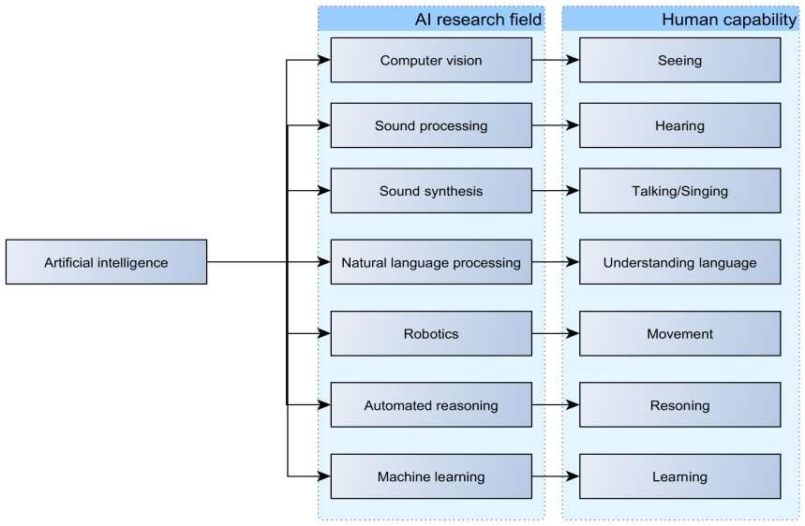
What is Machine Learning?

Slide 3
Introduction
Machine learning is the subfield of computer science that "gives computers the ability to learn without being explicitly programmed" (Arthur Samuel, 1959).
Evolved from the study of pattern recognition and computational learning theory in artificial intelligence, machine learning explores the study and construction of algorithms that can learn from and make predictions on data – such algorithms overcome following strictly static program instructions by making data-driven predictions or decisions, through building a model from sample inputs.

Slide 4
What is DBSCAN Clustering?
Density-Based Spatial Clustering of Applications with Noise (DBSCAN) is a density-based clustering algorithm, proposed by Martin Ester et al., 1996.
The algorithm finds neighbors of data points, within a circle of radius ε, and adds them into same cluster.
For any neighbor point, which its ε-neighborhood contains a predefined number of points, the cluster is expanded to contain its neighbors, as well.
However, for the unallocated points, if the number of points in the neighborhood is less than predefined threshold, the point is considered to be a noise.
So DBSCAN can discriminate the normal and noisy data, too.

Slide 5
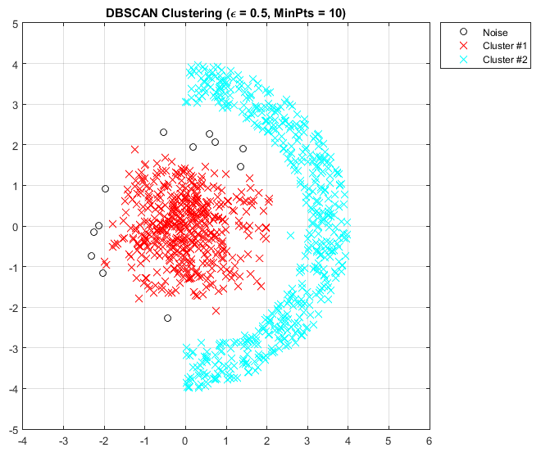
DBSCAN Clustering Example
A sample output of this algorithm follows. In the figure, you can see that DBSCAN successfully determined the data clusters, as well as noisy points. The parameters of algorithm, is show above the figure.

Slide 6
CONCEPT:
Density Reachability - A point "p" is said to be density reachable from a point "q" if point "p" is within ε distance from point "q" and "q" has sufficient number of points in its neighbors which are within distance ε.
Density Connectivity - A point "p" and "q" are said to be density connected if there exist a point "r" which has sufficient number of points in its neighbors and both the points "p" and "q" are within the ε distance. This is chaining process. So, if "q" is neighbor of "r", "r" is neighbor of "s", "s" is neighbor of "t" which in turn is neighbor of "p" implies that "q" is neighbor of "p".

Slide 7
Algorithm For DBSCAN:
Let X = {x₁, x₂, x₃, ..., x_{n}} be the set of data points. DBSCAN requires two parameters: ε (eps) and the minimum number of points required to form a cluster (minPts).
Start with an arbitrary starting point that has not been visited.
2) Extract the neighborhood of this point using ε (All points which are within the ε distance are neighborhood).
3) If there are sufficient neighborhood around this point then clustering process starts and point is marked as visited else this point is labeled as noise (Later this point can become the part of the cluster).
4) If a point is found to be a part of the cluster then its ε neighborhood is also the part of the cluster and the above procedure from step 2 is repeated for all ε neighborhood points. This is repeated until all points in the cluster is determined.
5) A new unvisited point is retrieved and processed, leading to the discovery of a further cluster or noise.
6) This process continues until all points are marked as visited.

Slide 8
DBSCAN Advantages:
DBSCAN does not require one to specify the number of clusters in the data a priori, as opposed to k-means.
DBSCAN can find arbitrarily shaped clusters. It can even find a cluster completely surrounded by (but not connected to) a different cluster. Due to the MinPts parameter, the so-called single-link effect (different clusters being connected by a thin line of points) is reduced.
DBSCAN has a notion of noise, and is robust to outliers.
DBSCAN requires just two parameters and is mostly insensitive to the ordering of the points in the database. (However, points sitting on the edge of two different clusters might swap cluster membership if the ordering of the points is changed, and the cluster assignment is unique only up to isomorphism.)
DBSCAN is designed for use with databases that can accelerate region queries, e.g. using an R* tree.
The parameters minPts and ε can be set by a domain expert, if the data are well understood.

Slide 9
DBSCAN Disadvantages:
DBSCAN is not entirely deterministic: border points that are reachable from more than one cluster can be part of either cluster, depending on the order the data are processed. For most data sets and domains, this situation fortunately does not arise often and has little impact on the clustering result: both on core points and noise points, DBSCAN is deterministic. DBSCAN* is a variation that treats border points as noise, and this way achieves a fully deterministic result as well as a more consistent statistical interpretation of density-connected components.
The quality of DBSCAN depends on the distance measure used in the function regionQuery(P,ε). The most common distance metric used is Euclidean distance. Especially for high-dimensional data, this metric can be rendered almost useless due to the so-called "Curse of dimensionality", making it difficult to find an appropriate value for ε. This effect, however, is also present in any other algorithm based on Euclidean distance.
DBSCAN cannot cluster data sets well with large differences in densities, since the minPts-ε combination cannot then be chosen appropriately for all clusters.
If the data and scale are not well understood, choosing a meaningful distance threshold ε can be difficult.

Slide 10
Conlcusion: (Extensions And Future Work)
Generalized DBSCAN (GDBSCAN) is a generalization by the same authors to arbitrary "neighborhood" and "dense" predicates. The ε and minpts parameters are removed from the original algorithm and moved to the predicates. For example, on polygon data, the "neighborhood" could be any intersecting polygon, whereas the density predicate uses the polygon areas instead of just the object count.
Various extensions to the DBSCAN algorithm have been proposed, including methods for parallelization, parameter estimation, and support for uncertain data. The basic idea has been extended to hierarchical clustering by the OPTICS algorithm. DBSCAN is also used as part of subspace clustering algorithms like PreDeCon and SUBCLU.
HDBSCAN is a hierarchical version of DBSCAN which is also faster than OPTICS, from which a flat partition consisting of the most prominent clusters can be extracted from the hierarchy.

